Slide 1
Accommodations 101:
Attendance
Office of Accessibility
The University of Akron
Simmons 105
Notes:
Welcome to Accommodations 101: Attendance, presented by the Office of Accessibility at The University of Akron.

Slide 2
Objectives
Participants will...
  Learn about the types of disabilities that affect attendance
  Learn about the various types of attendance accommodations
  Discuss student expectations and limitations to accommodations
Notes:
During this presentation, viewers will learn basic information about the Office of Accessibility.
Participants will also have the opportunity to gain additional understanding of the various types of disabilities that may affect a student’s attendance, as well as the different types of attendance accommodations that the Office of Accessibility coordinates.
Additionally, participants will gain further understanding the limitations to this accommodations, and what the student expectations are when they receive this accommodation.

Slide 3
Attendance Accommodations
Notes:
Now, we will talk specifically about the attendance accommodations that some students with disabilities might receive.

Slide 4
Types of Disabilities
Some students may have a disability in which they experience a “flare up” of symptoms
Due to an exacerbation of symptoms, these students may need an attendance accommodation

Slide 5
Health-Related Disabilities
Crohn’s Disease
Cystic Fibrosis
Headache Conditions
Heart Conditions
Notes:
Next we are going to discuss some of the more common disabilities that affect attendance, and talk briefly about some of the symptoms of these conditions that can affect attendance.
Our first major disability category that can often cause absences are health related disabilities. Under this category, we see diagnoses such as Crohn’s disease, cystic fibrosis, headache conditions, and heart conditions.
Students who have Crohn’s disease may have some trouble with their digestive system. A flare up of this condition may cause severe abdominal pain, or general pain throughout the body. They may be unable to sit through a class during these times, or may need to see a doctor for treatment.
Cystic Fibrosis is a chronic illness that can cause respiratory distress. Many students with this diagnosis will need to receive regular hospital based treatments every few months. Additionally, the condition can flare up, also causing illness and frequent hospitalization. It is important for these students to keep their regularly scheduled treatment appointments, although they may not have a choice as to when they will be. In those cases, the student may need to miss class for the regularly scheduled treatments.
Some students may suffer from headache conditions that cause severe migraines. Some students with this diagnosis report migraines that are so severe that they are unable to drive, see or be in room with lighting. Some also report migraines severe enough to cause vomiting. In these cases, it is often safest for the student to stay home or in their residence hall.
Other students may report having heart conditions. Some symptoms of these types of conditions include extreme fatigue, weakness, and even passing out. Students may need to seek treatment or simply just rest if their symptoms flare up.

Slide 6
Neurological Disabilities
Muscular Dystrophy
Multiple Sclerosis
Neuropathy
Notes:
Another category of disabilities that may affect attendance are Neurological Disabilities.
Some students may have muscular dystrophy. For these students, symptoms may include general weakness, and sensitivity to extreme temperatures. In extremely hot or cold temperatures, it may not be safe for these students to be out in the conditions.
Students with multiple sclerosis can see a wide variety of symptoms, depending on how the disease affects them individually. During a flare up, they may be in pain, may not be able to see well, and amy not be able to concentrate. These flare ups can, at times, come without warning, and may affect different parts of the body each time.
Students who have neuropathy may have flare ups of extreme pain. At times, this may make it difficult to walk.

Slide 7
Physical Mobility Disabilities
Arthritis
Chronic Back Conditions
Notes:
Some students with physical mobility issues may also have an attendance accommodation.
Students who have arthritis may have difficulty getting to class at times, depending on the severity of the arthritis and where it is located. For some of these students, extreme heat or cold may make their symptoms more intense.
Students who have chronic back pain may have extreme flare ups that make it difficult to sit, stand, walk, or even get out of bed.
It may be important to recognize that for these students, and for many others with an attendance accommodation, that when their disability flares up, there may not be anything that a doctor or emergency room can do for them. Many of these students simply need to rest until their symptoms subside. Some instructors may want a doctor’s note for every absence, but should know that these students do not always seek medical care during a flare up.

Slide 8
Psychological Disabilities
Bipolar Disorder
Depression
Panic Disorder
Post-Traumatic Stress Disorder
Notes:
At times, students with psychological disabilities may receive an attendnace accommodation, depending on the diagnosis and severity of the condition.
For students with bipolar disorder, at times the depressive states can make students lose motivation for daily tasks or make it difficult to get out of bed. At other times, the manic states of this condition can cause little to no sleep, or even hospitalizations at times.
In severe cases of students with depression, a student may not be able to get out of bed or may be suicidal, requiring treatment or hospitalizations.
During a flare up, students who have panic disorder may not be able to leave the house without having a panic attack, or may have a panic attack while on campus that may prevent them from attending classes until they can get symptoms under control.
Students who have post traumatic stress disorder may have exacerbations that take on many forms, including panic attacks, paranoia, anger outbursts, or agoraphobia.
It should be noted that students are only given attendance accommodations in severe cases, but it is important that these students take care of themselves first. Ignoring symptoms or not seeking treatment can lead to additional absences and other complications that may muddle making up work for a class.

Slide 9
Types of Attendance Accommodations
Absence for All or Part of Class
Unexpected Breaks
Restroom Break During Class
Tardy or Absent
Tardy or Absent (VA)
Absence for Hospital Procedures
Notes:
There are a number of different types of attendance accommodations that a student may have, based on the symptoms of their disability.
The first is a general attendance accommodation. In this accommodation, it is stated that the effects of the student’s disability may cause them to miss class, and that we ask for flexibility in attendance policies and make up work when possible.
Some students may just need to take a break and step out of class for a variety of reasons. Some may need to use the restroom due to their disability, test blood sugar levels, stretch their legs or back, or manage some symptoms of anxiety. This accommodation is used for students who want their instructors to know that they do not intend to disrupt class by taking a break, and to let the instructors know that if a break is needed, it is for disability related reasons.
Some students may just need their instructors to know that they may need a restroom break during class. Other students may want more confidentiality and will choose to use the generic “unexpected breaks” accommodation that is listed above.
Other students will want to let their instructors to know that, at times, due to their disability, they may be late to classes. Some examples may include students with chronic pain taking longer to walk on some days compared to others, or others that may need to use the restroom before attending classes.
Veteran students that have an attendance accommodation may also have a specific one related to appointments at the VA. For these students, the VA is not often lenient about appointment times, and veterans often don’t have a choice for when their appointment times are. However, missed appointments may not be able to be rescheduled for months at a time, so it is important that these students attend these appointments in order to receive the necessary care.
Lastly, some students may require regular hospital-based treatments based on their disability. These are often planned in advance, so students know when they will be out of classes. The Office of Accessibility works with these students and their instructors to make arrangements for missed work and exams for these procedures.
Again, it is important to remember that many students will not have documentation for absences. They have chronic health issues, and there is nothing that a doctor can do to relieve the acute symptoms. For many, the doctor will tell them to take medication they already have and to rest. For prolonged absences, the Office of Accessibility will often ask students for documentation to substantiate the missing classes.

Slide 10
How much is too much?
Attendance is ultimately up to the instructor
If too much class is missed that a student cannot meet the objectives of the course we can discuss the student’s options
  Finish the class and take the grade
  Incomplete
  Drop
  Medical Withdrawal
Notes:
Instructors will often ask how many classes a student can miss with an attendance accommodation. Ultimately, attendance and how attendance policies are implemented is entirely up to the instructor.
What the Office of Accessibility asks is that instructors be flexible whenever possible. However, sometimes students miss too much class, and won’t be able to be successful in the course. Consider all of the options for the student – have they been able to demonstrate an understanding of the material? Can they do presentations for the instructor? What have they missed by being out of class – is it lecture material that can be found by getting a copy of someone’s notes and reading the book, or is it enriching discussion that cannot be made up elsewhere?
When students miss a significant amount of class and may not be able to make up the work or the lecture material, the student and their disability specialist will sit down and discuss what the different options are. These options typically include the following:
- Completing the work and taking whatever grade is earned
- Discussing an Incomplete with the instructor. If something occurs late in the semester, and most of the work has been completed, a student may just need a bit of extra time to finish the course. The terms of the incomplete are between the instructor and the student.
- If excessive absences occur early in the semester, the student may be able to drop the class.
- If the absences occur after the drop deadline, the student can look into a possible medical withdrawal.

Slide 11
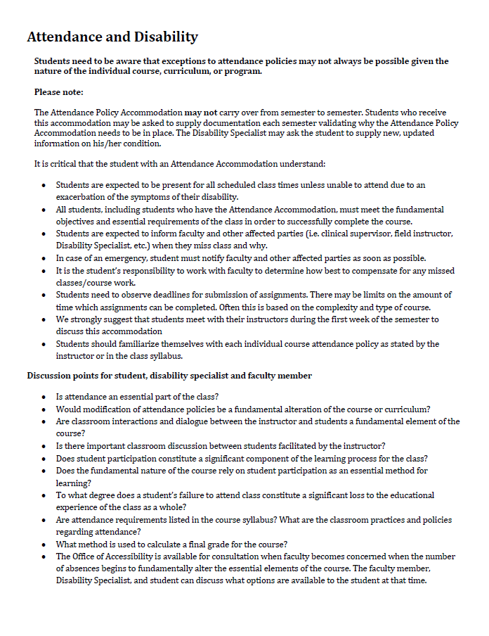
Attendance Agreement
Notes:
The Office of Accessibility does not condone excessive absenteeism, and the student’s expectations in this accommodation is made clear. Pictured here is the attendance and disability agreement that is reviewed and signed by the student during their initial intake appointment, or at the time the accommodation is assigned to the student.
This agreement reviews the student expectations, responsibilities, and faculty consideration points. This agreement is also included with the accommodation letter that is sent to faculty and the student.

Slide 12
Student Responsibilities
Provide the Office of Accessibility with timely and adequate documentation from an appropriate treatment professional.
Keep his/her Disability Specialist informed and provide updated documentation if disability changes.
Request accommodations each semester as needed.
Discuss accommodations with faculty and staff members as needed.
Students with disabilities are held to the same academic and behavioral standards as all other students.
Notes:
In general, these are our expectations for all of our students. These are reviewed during the intake appointment with the student, and again at any point in time that might be necessary.
Students are expected to provide timely and adequate documentation from a professional, and to get registered with the Office of Accessibility. Students must be registered with the Office of Accessibility in order to receive accommodations. Accommodations are not retroactive, so they are only implemented from the time that the accommodation letters are requested from the Office of Accessibility. In the absence of an accommodation letter, no accommodations are required to be provided.
They are also expected to request accommodation letters each semester, and discuss their accommodations with their instructors. Furthermore, students are expected to uphold the same academic and behavioral standards as any other student.

Slide 13
Student Responsibilities
Be present for classes
Complete all the same coursework as other students
Inform faculty and Office of Accessibility about disability-related absences
Work with instructors to determine make-up work
Notes:
In addition to the general expectations for all students with disabilitieis, those listed here are expected of students who receive an attendnace accommodation.
We expect that students will be present for all classes, unless an exacerbation of their disability prevents them from doing so. This means that non-disability related absences are not covered under the attendance accommodation.
Even is classes are missed, students are still expected to complete the same work as any other student in the class needs to do in order to be successful in the course.
Students are expected to inform their faculty members and the Office of Accessibility if there are disability-related absences.
At times, the student’s disability specialist may contact instructors to let them know the situation, and to help coordinate any make up work or missed exams. Otherwise, students are expected to work with their instructors to determine appropriate make up work.

Slide 14
Faculty Responsibilities
Understand what attendance accommodation might mean
Understand the fundamental requirements for your class
Consider reasonable alternatives if students miss class
Contact the Office of Accessibility with questions/concerns about accommodations or student attendance
Use syllabus statement to inform students how to access accommodations
Notes:
Faculty should know what the fundamental requirements are for your class. The Office of Accessibility cannot determine if the student can meet the course requirements, as the instructor is the expert on that topic.
Faculty may want to consider reasonable alternatives if students miss class. Is there a way for them to make up missed points for the day? If students miss an exam or an assignment, what is a reasonable timeframe for making up the test or assignments?
Instructors should feel free to contact the Office of Accessibility if a student is missing too much class, or if there are any questions about the accommodation and how to implement it in the classroom.
Furthermore, using a standard syllabus statement allows students to know where to go to get needed accommodations, and may help remind students to request accommodations if they have not already done so.

Slide 15
Recommended Syllabus Statement
Standard Syllabus Statement
In pursuant to University policy #3359-38-01, The University of Akron recognizes its responsibility for creating an institutional atmosphere in which students with disabilities have the opportunity to be successful. Any student who feels he/she may need an accommodation based on the impact of a disability should contact the Office of Accessibility at 330-972-7928 (v), 330-972-5764 (tdd) or access@uakron.edu. The office is located in Simmons Hall Room 105.
After the student’s eligibility for services is determined, his/her instructors will be provided a letter which will outline the student’s accommodations.
Notes:
The Office of Accessibility’s recommended Syllabus statement can be found on our website at www.uakron.edu/access. This was developed so that students have all the information they need if they feel they may need accommodations based on disability.

Slide 16
Benefits of Syllabus Statement
Normalizes the accommodation process
Creates a positive and welcoming environment
Creates a collaborative vehicle for making legally mandated accommodations
Serves to educate students who need accommodations
Serves as a reminder to students to request accommodations.
Notes:
The standard syllabus statement is important for a number of reasons.
First, having the statement on the syllabus normalizes the accommodation process for students, as they will know that their instructors are aware of what accommodations are.
It creates a welcoming environment for students who may be hesitant to request accommodations, letting them know that there is an office that can help them with the process.
It serves to educate students who are not registered with the Office of Accessibility on who to contact and what the process is for receiving accommodations.
And finally, for some students it can serve as a reminder to request accommodations if they have not yet done so for the semester.

Slide 17
The Office of Accessibility values collaboration between you, your students and our office. Thank you for your time and participation.
Office of Accessibility
Simmons Hall 105
330-972-7928 www.uakron.edu/access
If you would like an electronic copy of this presentation, please feel free to contact the office at access@uakron.edu.
Notes:
The Office of Accessibility welcomes any questions or concerns that faculty and staff have when working with students with disabilities. Please feel free to contact the office to discuss the information in this presentation, or with any other questions or concerns.

